Slide 1
Vegetarianism and Family Health
  John Livesey PhD

Slide 2
Liver studies hint vegies suit humans
31 August 2006
  Scientists studying kidney-stone diseases have stumbled across evidence that humans may be genetically more suited to vegetarianism than meat eating.
  The discovery was made when the placement of an enzyme known as AGT, which is linked to the rare kidney-stone disease PH1, was found in one area of the liver in herbivores and another in carnivores, Professor Chris Danpure, of University College London, said yesterday.
  Evolutionary science indicated that about 10 million years ago the distribution of the enzyme in human ancestors appeared to change from favouring a omnivorous diet to plant eating.
  Humans began eating meat only in the past 100,000 years, a habit which has increased dramatically in recent times.
  "It would appear that the diet we have now is incompatible with the distribution of this enzyme, which was designed for a herbivore diet, not meat eating," he said.
  The human placement of the enzyme was the same as in rabbits, sheep and horses.
  "One of the consequences of this could be the high frequency of kidney stones in humans, especially in western societies."

Slide 3
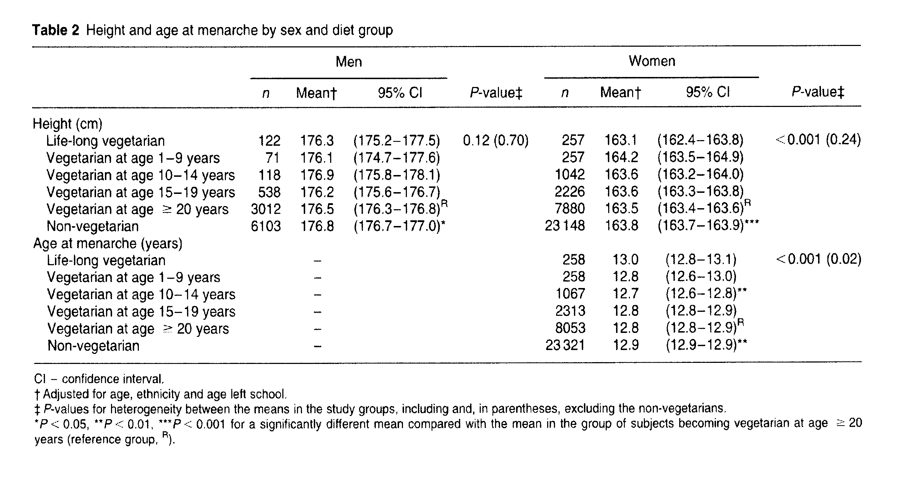
Growth and development of vegetarian children

Slide 4
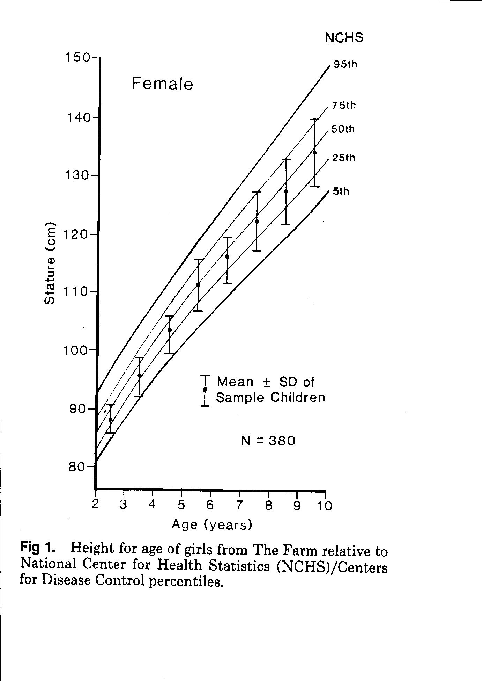
Is raising a child vegan a form of child abuse?

Slide 5
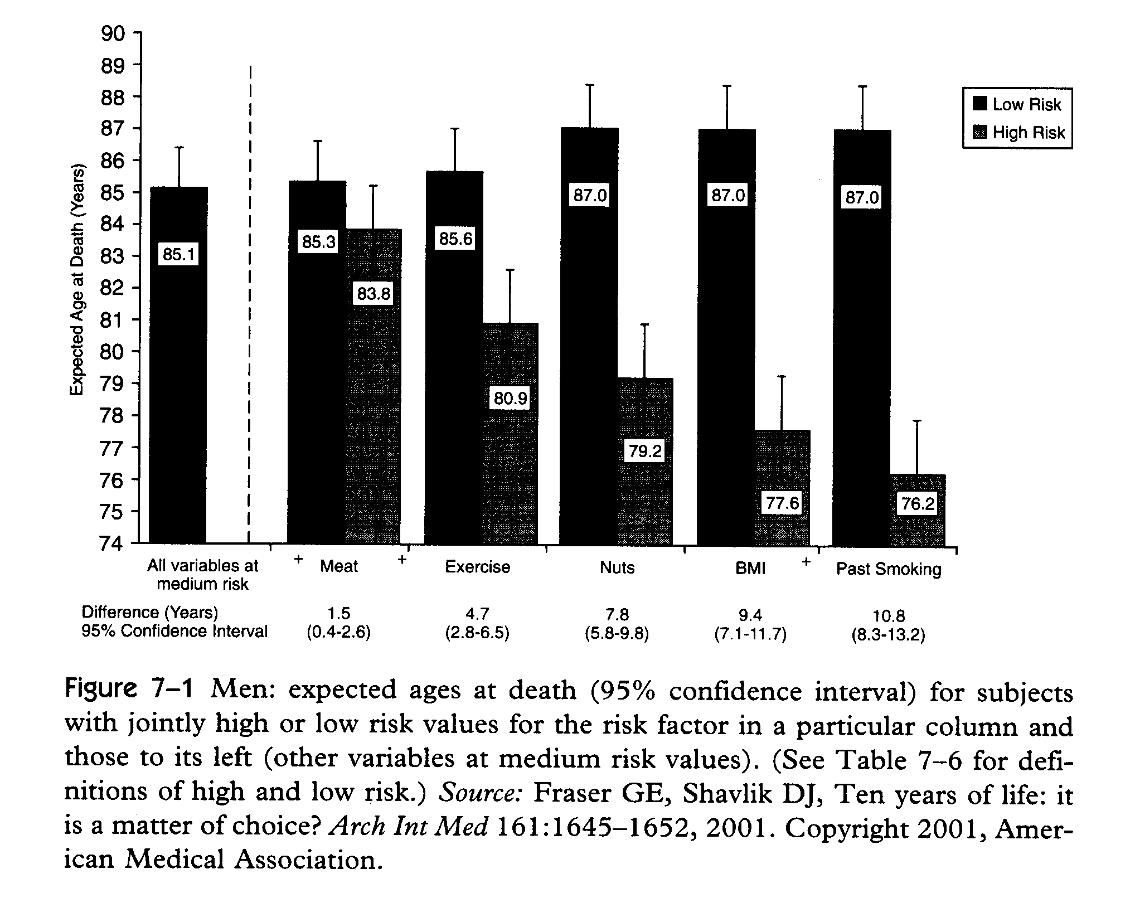
Vegetarianism and life expectancy

Slide 6
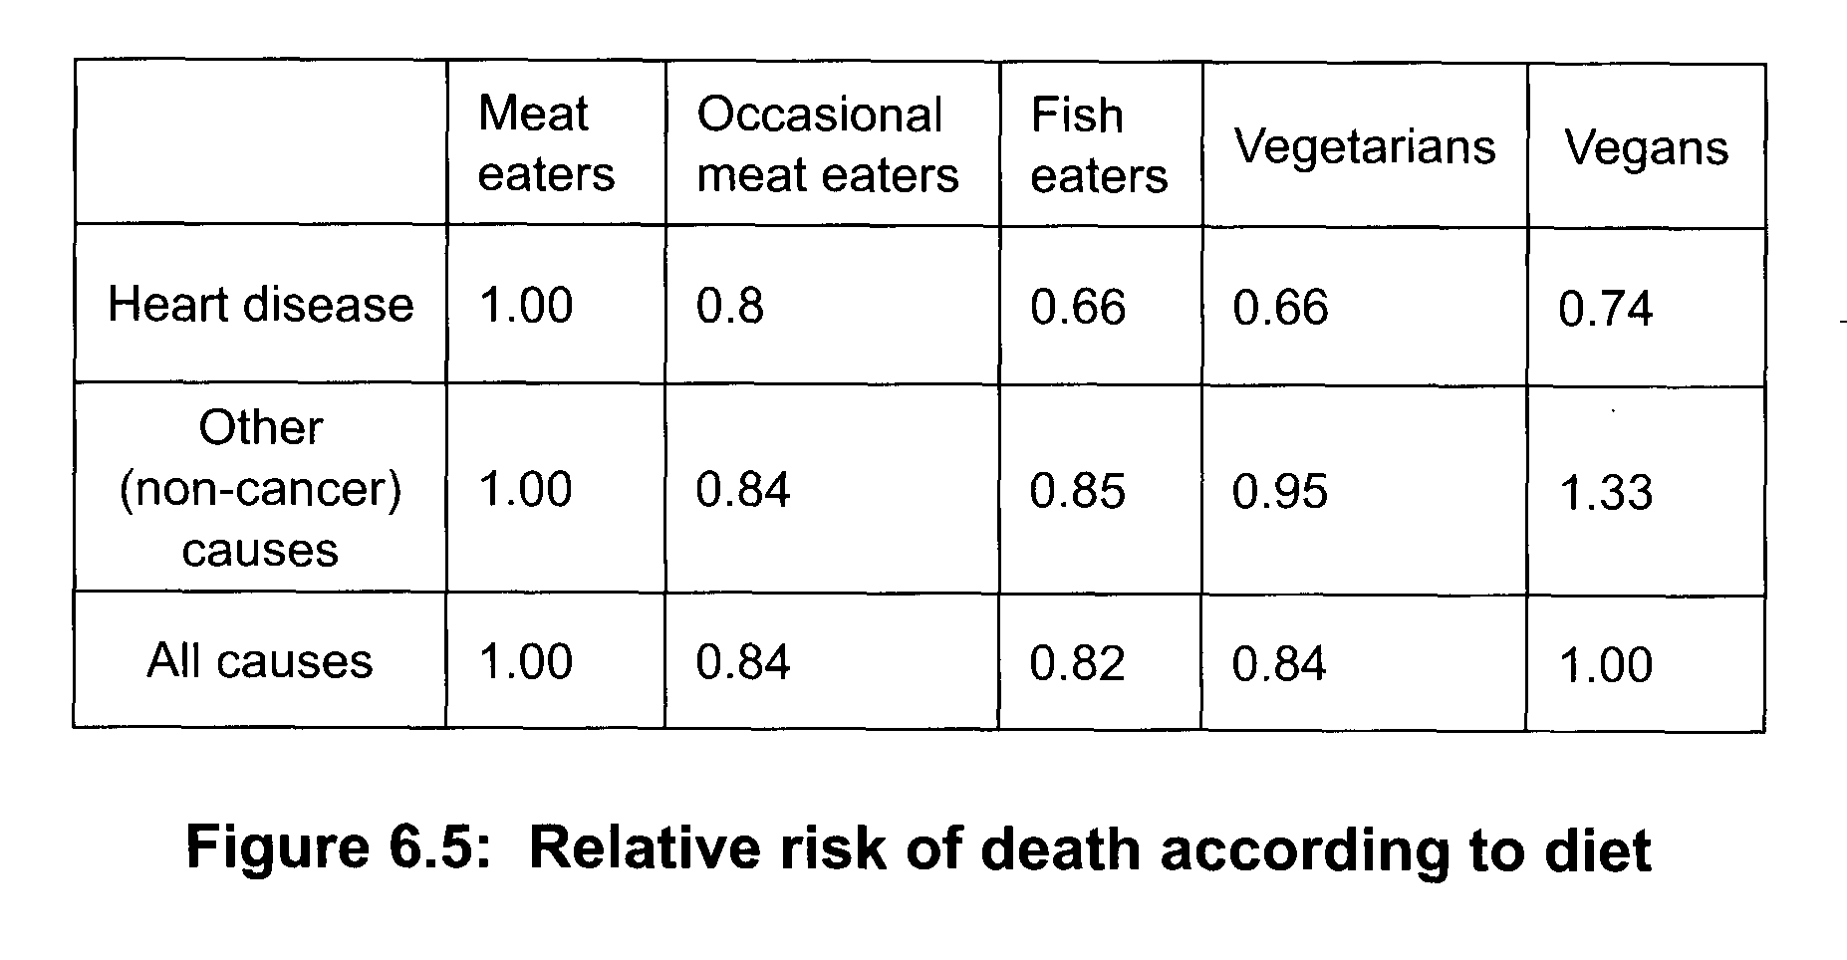
Veganism and death rate

Slide 7
Which foods should we eat?
Hints from epidemiology

Slide 8
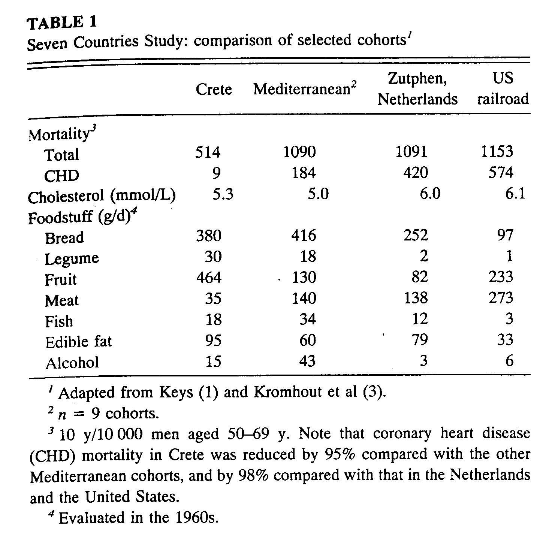
Diet and death rate

Slide 9
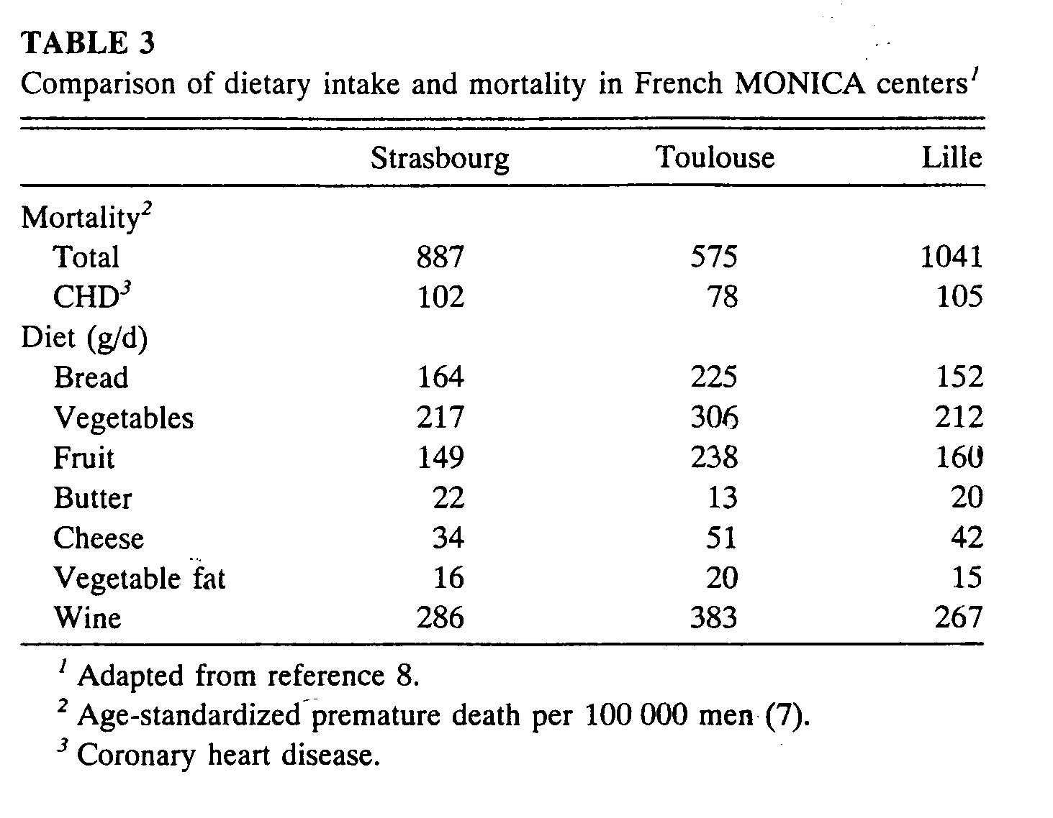
Diet and death rate

Slide 10
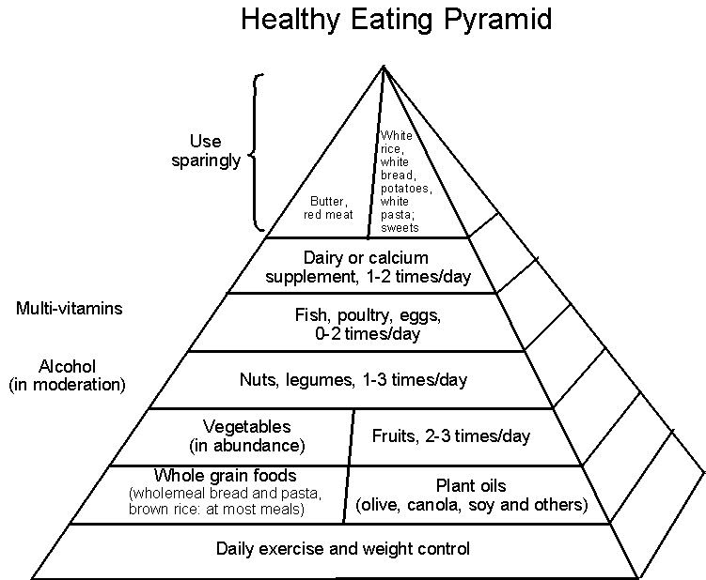
Prof Walter Willett, Harvard Medical School

Slide 11
Super foods

Slide 12
Nuts
30 grams per day

Slide 13
Nuts

Slide 14
Legumes
(pulses)
At least 30 grams per day
  beans
  peas
  soy

Slide 15
Food Habits in Later Life Study
  785 participants
  greater than 70 yrs old
  Japanese
  Swedes
  Greeks in Greece
  Greeks in Australia
  Anglo-celtic in Australia
  followed for 7 years
  169 died
Diet categories
vegetables
legumes
fruits and nuts
cereals
dairy
meat
fish
alcohol
mono/sat fat
  The most consistent predictor of longevity was legume consumption

Slide 16
Fibre
Comes from whole plant foods
Many heath benefits, eg
- reduced heart disease
- improved mental health
- lower risk of diabetes
Insoluble – eg. whole wheat, soya beans
~ maintains bowel function
Soluble – eg. oats, barley, eggplant, fruit, beans
~ beneficial metabolic effects, eg
- lowers bad cholesterol
- prolongs satiety via fermentation in bowel

Slide 17
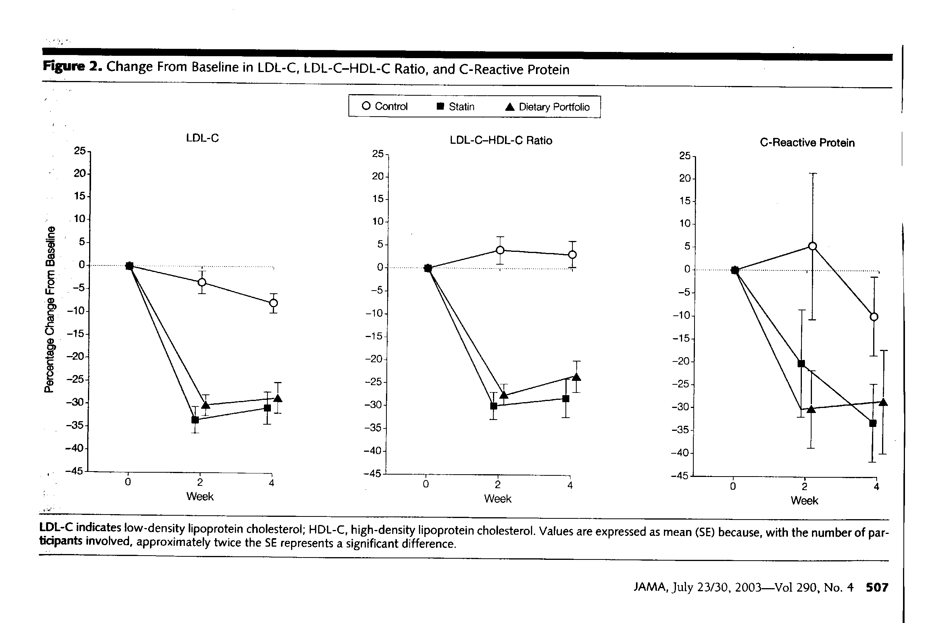
Portfolio Diet

Slide 18
Portfolio Diet
  Soluble fibre: oats, barley, beans, psyllium
  Nuts: almonds
  Soy: tofu, soy milk
  Plant sterol-enriched margarine: Logicol

Slide 19
Fibre
Whole grains/legumes: also rich in
~ minerals, eg. iron, zinc
~ vitamins
~ pro-vitamins, eg choline, betaine
Think outside the square
~ buckwheat, quinoa, amaranth, millet, rye
~ ground flaxseed
~ whole wheat pasta
~ tempeh, edamame
~ seaweed (karengo, laverbread, wakame)
At least 30 grams of fibre per day
~ Cretans 60-100g/day, NZers 18g/day

Slide 20
Fruit
With every meal
Provides vitamin C, potassium, fibre
Viatmin C improves absorption of iron
Citrate improves absorption of zinc
Alkalinizes diet
Improves bone health
Increases satiety
Reduces risk of Alzheimers disease
Berries may be especially beneficial

Slide 21
Vegetables
Eat coloured vegetables
~ green
~ orange
~ red
~ purple
~ yellow
Minimise (white) potatoes
~ best eaten cold next day

Slide 22
Calcium
Improves bone health
Lowers bad cholesterol
Lowers blood pressure
Reduces saturated fat absorption
Reduced risk of kidney stones
Increases alkalinity of diet
Reduces risk of colon cancer

Slide 23
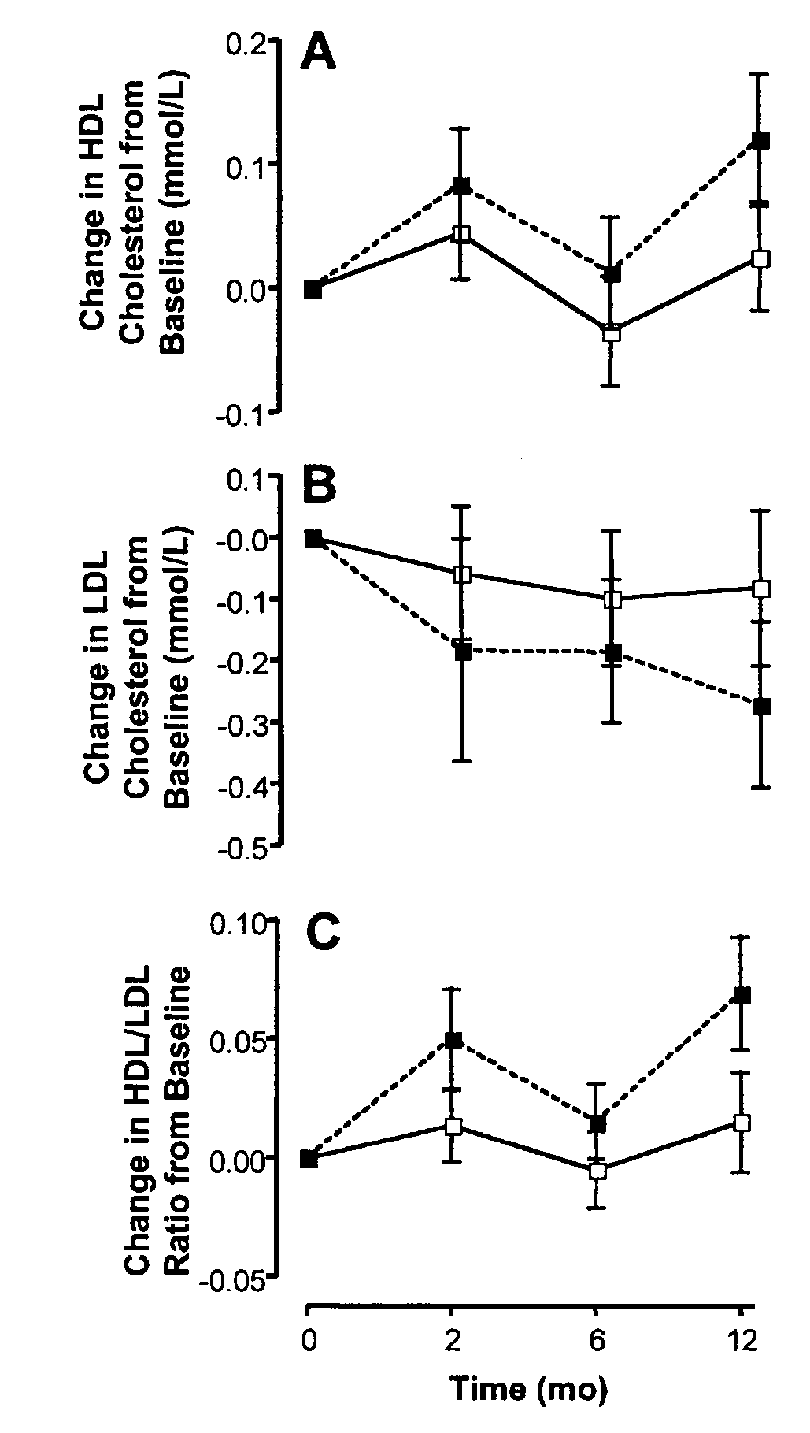
Calcium citrate improves lipids
1000mg calcium per day

Slide 24
Calcium
At least 1000 milligrams per day
Green vegetables
Fortified soy milk
Multi-mineral tablets
Low fat cheese?
Not milk
~ need 1 litre per day
- 400 calories
- no fibre
- saturated fat
- acidifying
- cholesterol
- doesn't prevent osteoporosis
- insulinogenic

Slide 26
Potential NZ mineral deficiencies
Iodine
~ kelp (¼ tsp per week)
~ multi-mineral tablets
Selenium
~ brazil nuts (one per day)
~ multi-mineral tablets

Slide 27
Good fats
Mono-unsaturated
~ canola oil
~ virgin olive oil
Omega-3
~ flaxseed (fresh ground better than oil)
~ canola
~ walnuts

Slide 28
Vitamin D
Bone health
Cancer prevention
Healthy heart
Reduced type I diabetes
Lowers blood pressure
Less arthritis
Less multiple sclerosis
Less depression
Less chronic pain

Slide 29
Vitamin D
Get your family’s blood levels measured
Take prescription vitamin D if necessary

Slide 30
Vitamin B₁₂
Vegetarians and vegans at risk
~ lethargy
~ neurological damage
Get your blood B₁₂ and homocysteine measured
Measure MMA also if in doubt
Take 50 micrograms B₁₂ per day anyway

Slide 31
“Poisons”
Salt
Saturated fat, eg
~ butter
~ dairy cream
~ coconut oil
Refined carbohydrates, eg
~ sugar
~ white bread
Non-cheese dairy products eg
~ milk
~ yoghurt

Slide 32
Obesity

Slide 33
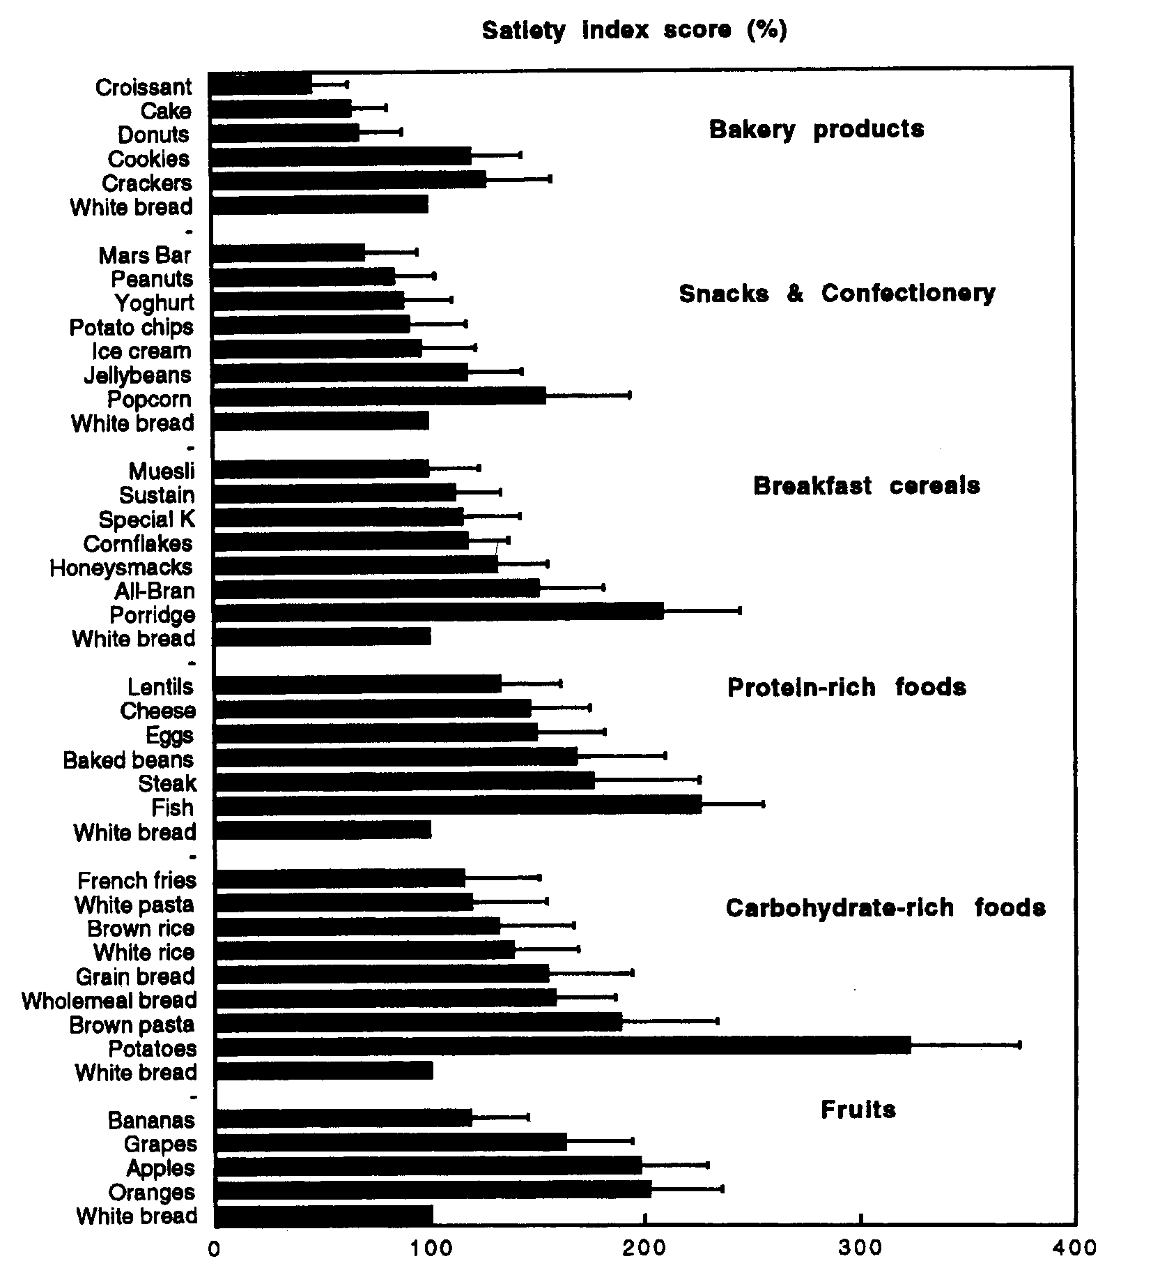
Satiety
85
100
134
166
166
170

Slide 34
Satiety
Correlation with food characteristics
Palatability –0.64
Fat –0.43
Protein +0.37
Fibre +0.46
Water +0.64
Weight +0.66

Slide 35
Caloric restraint
~ eat to 80% full
Exercise
~ 10,000 steps per day (pedometer)
~ 4 hours standing per day

Slide 36
Infants and toddlers
(0 - 3)
Breast milk
~ or commercial formula
Vitamins B₁₂ and D
Appropriate solids
Sufficient calories

Slide 37
Introducing solids
4-6 mths: Iron-fortified infant cereal
6-7 mths: Vegetables/fruits (puree/mash)
7-8 mths: Protein rich foods. Juices.
~ legumes, tofu.
8-9 mths: Finger foods. Teething foods. Whole grains
10-12 mths: Family food.
For children, don’t over do high-fibre low-calorie food.

Slide 38
Sneaky Dad’s Pudding
Blend together:
1½ cups frozen berries
1 banana
2 tsp cocoa powder
2 tsp flaxseed oil (fresh!)
4 tsp nut butter
2 tsp fortified soy milk
¼ avocado
Becoming vegan. B. Davis & V. Melina

Slide 39
And finally, the really good news ....

Slide 40
Chocolate is good for you!

Slide 41
Cocoa-containing foods halve death rate
470 Dutch men, average age 72 at study start in 1985.
By 2000, 67% had died.
One third consumed no cocoa-containing foods
Middle third consumed 0.9 grams cocoa per day
Top third consumed 4.2 grams cocoa per day
~ equivalent to 10 grams good quality dark chocolate
Top third had 45 - 50 % lower death rate than bottom third of cocoa consumers

